Slide 1
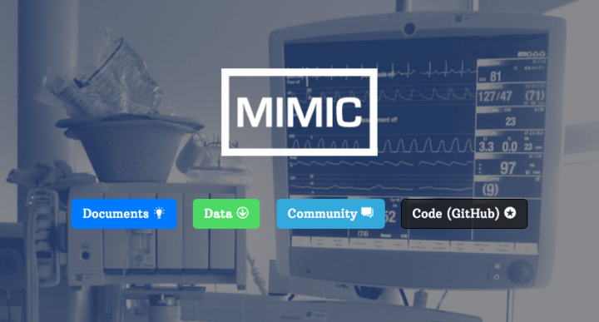
Python Benchmarks for MIMIC-III ("Public Benchmarks for Machine Learning Researchers in Health Care" )
Based on the GitHub Repository and related article Multitask Learning and Benchmarking with Clinical Time Series Data
by
Hrayr Harutyunyan, Hrant Khachatrian, David C. Kale, Greg Ver Steeg, and Aram Galstyan.
Patricia Whitley
HMI 7450
Professor Dominic Thomas

